Slide 1

Access modifiers: public vs. private
By Min Thet Naing

Slide 2
The public access modifier
By Min Thet Naing

Slide 3
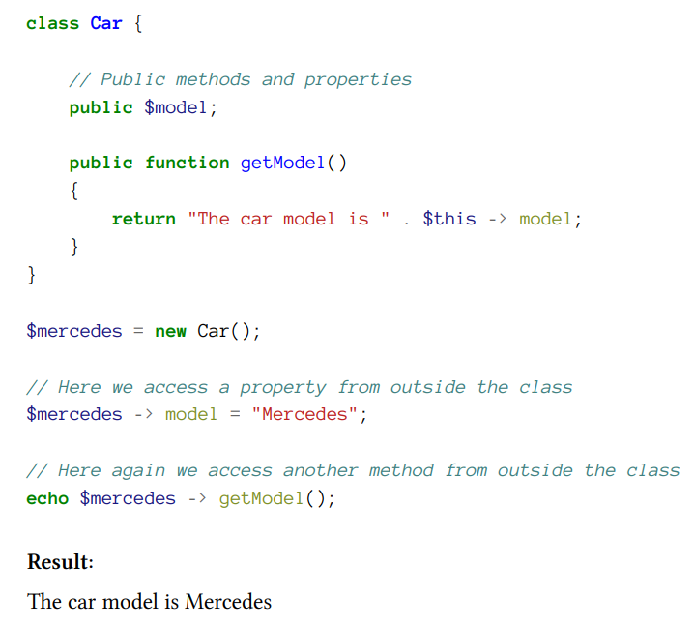
By Min Thet Naing

Slide 4
The private access modifier
By Min Thet Naing

Slide 5
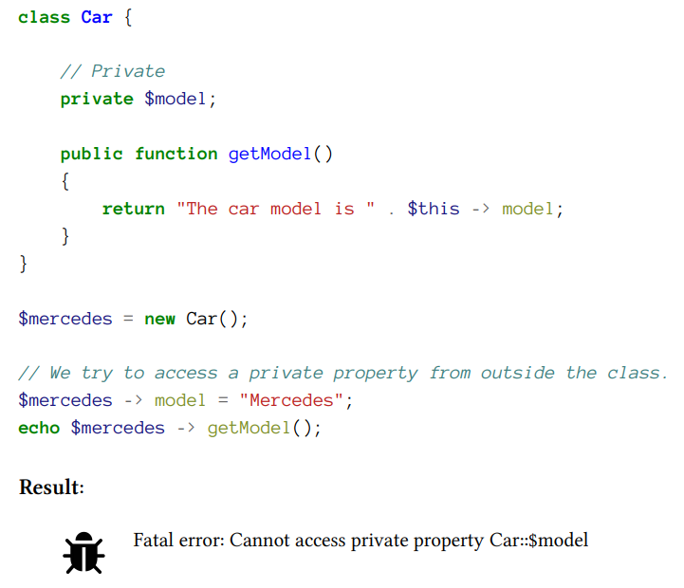
By Min Thet Naing

Slide 6
How to access a private property?
By Min Thet Naing

Slide 7
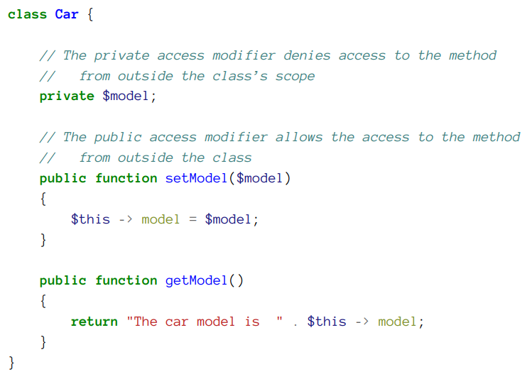
By Min Thet Naing

Slide 8
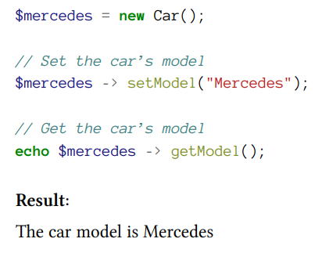
By Min Thet Naing

Slide 9
Why do we need access modifiers?
By Min Thet Naing

Slide 10
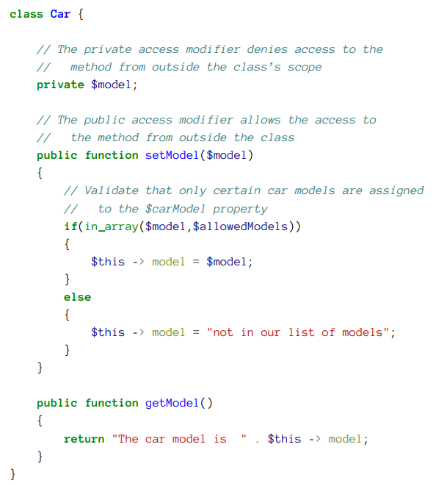
By Min Thet Naing

